Slide 1
APS106 – Design Problem WORDLE

Slide 2
Agenda
Problem Background
Learning Objectives
Coding

Slide 3
WORDLE: The Viral Pandemic Game
NY Times hosted online word-guessing game, but can only play once a day.
6 guesses to try and get the correct 5-letter word.
Color coding of letters to help indicate how close you are to the correct word.

Slide 4
WORDLE: Rules of the Game
For each letter in your guess:
Green = Correct letter, in correct position.
Yellow = Correct letter, in wrong position.
Grey = Wrong letter not in word.
The game ends if you either:
Get the word fully correct.
Run out of attempts (6).

Slide 5
Learning Objectives
Practice with user input
Understand loops and conditionals
Understand string manipulation and comparison

Slide 6
Engineering Design Process
Learn to define the problem
Practice defining test cases
Develop an algorithm plan (i.e. a workflow!)
Program your solution and debugging

Slide 7
Some Reminders

Slide 8
Input
Python has a built-in function named input for reading text from the user.
The general form of a input function call:
The argument is the text you want displayed to the user.
“What is your name?”
The value returned by the input function is always a string.
input(argument)

Slide 9
Importing Functions and Modules
The general for of an import statement is:
import module_name
To access a function within a module:
module_name.function_name

Slide 10
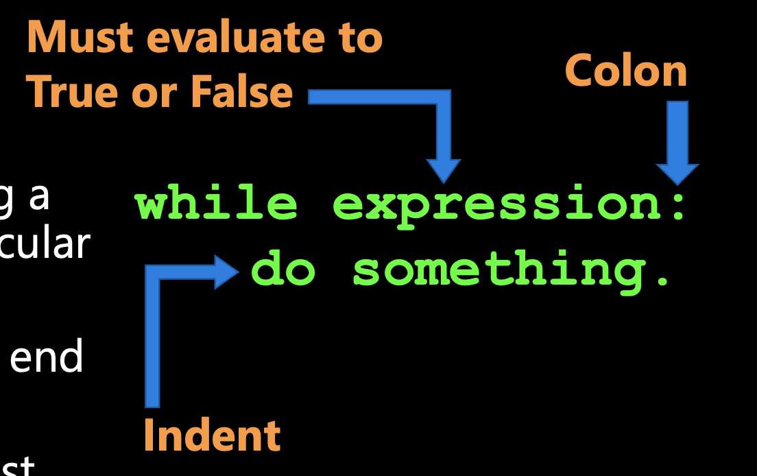

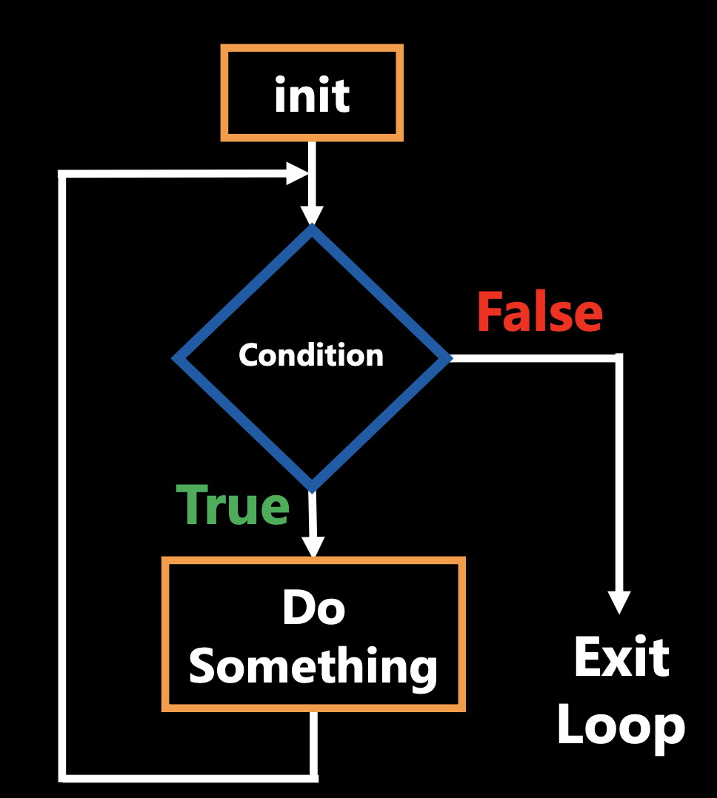
While Loops
▪ The while loop keeps executing a piece of code as long as a particular condition is True.
▪ There must be a colon (:) at the end of the while statement.
▪ The action to be performed must be indented.

Slide 11
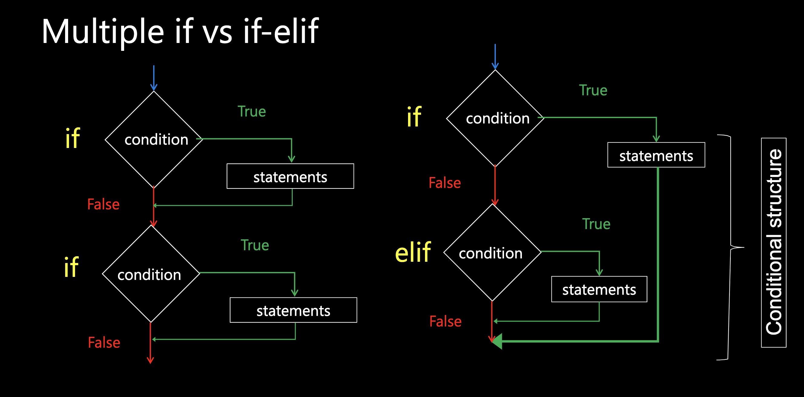
Conditional Statements: If, Elif and Else

Slide 12
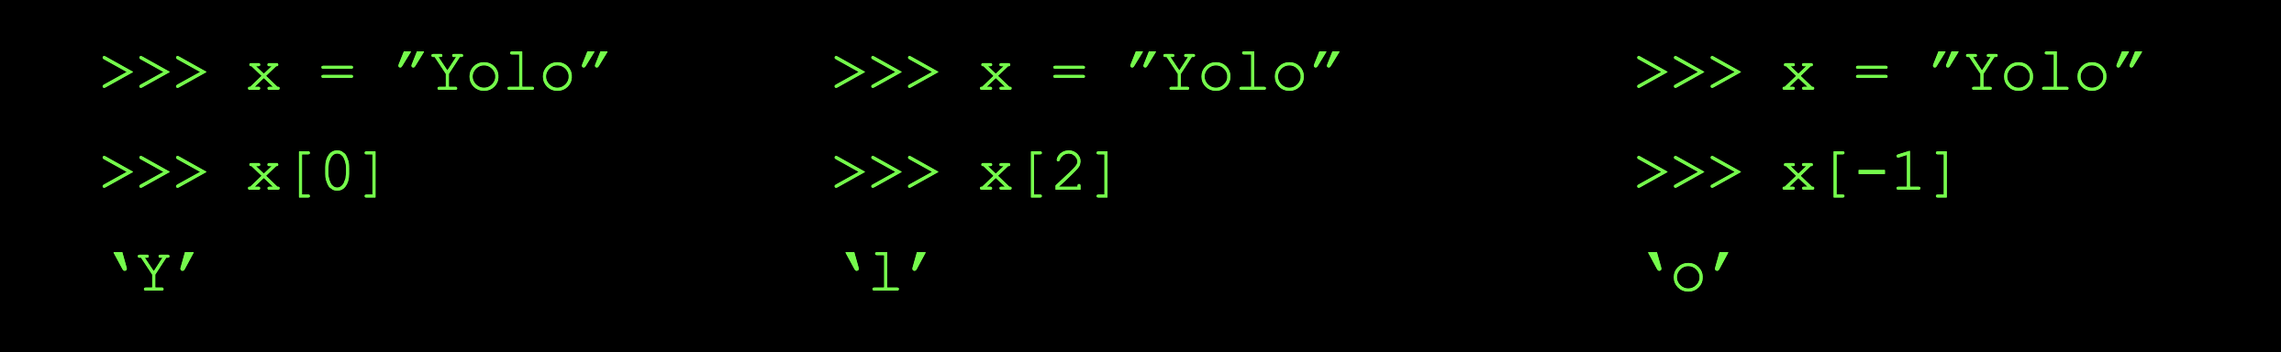
String Indexing
An index is a position within the string
A particular element of the string is accessed by the index of the element surrounded by square brackets
Positive indices count from the left-hand side, beginning with the first character at index 0, the second index 1, and so on...
Negative indices count from the right-hand side, beginning with the last character at index -1, the second last at index -2, and so on...

Slide 13

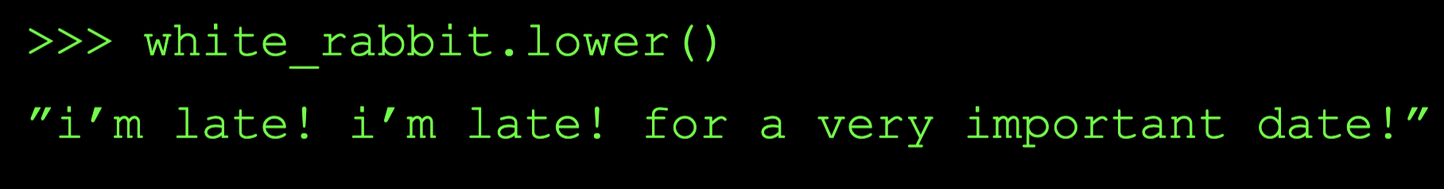
String Methods
Strings are objects and just like other objects, the str type has associated methods that are only valid for strings
Example: lower is a string method that generates a new string that has all lower case characters

Slide 14
For loops
name = ‘Sebastian’
for character in name:
print(character)
Output:
S
e
b
a
s
t
i
a
n
Specify what the values are in.
What is the iterable?
An iterable is an object that can be iterated over.
Strings are iterable (we know these from last week).

Slide 15
while
for
i = 0
counter = 0
while i < len(chrome_4):
if chrome_4[i] == 'A':
counter += 1
i += 1
counter = 0
for character in chrome_4:
if character == 'A':
counter += 1
Differences
In the while loop, the loop variable (i) was the index of each character, while in the for loop the loop variable (character) is the value of each character.

